Slide 1

Forecasting Electricity Demand Using Recurrent Neural Networks
A Deep Learning Approach for Smart Grid Management
ADTA 5560 Recurrent Neural Networks
Sai Satish Pallapolu
Notes:
001

Slide 2
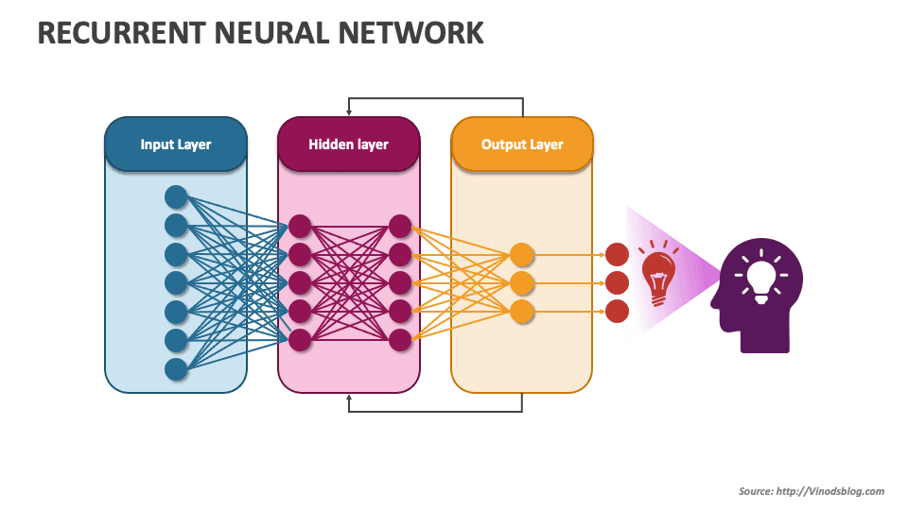
Abstract
Key Points:
Accurate electricity demand forecasting is important for grid stability especially for renewable energy.
This project uses RNN LSTM, GRU, Simple RNN to predict hourly demand using U.S. EIA data between 2022 and 2025.
Achieved exceptionally low MAE with LSTM outstanding other models.
Demonstrated the importance of data preprocessing, feature engineering, and avoiding data leakage.
Notes:
001

Slide 3

Introduction
Background:
Electricity grids require accurate demand and supply balance. Various renewable energy makes forecasting challenges difficult.
Intended Audience:
Data scientists, analytics professionals, graduate students, and energy stakeholders interested in deep learning for smart grid optimization.
Research Questions:
How accurately can we forecast hourly demand?
What are the key temporal patterns in consumption?
How do external factors (e.g., holidays) impact demand?
Notes:
001

Slide 4
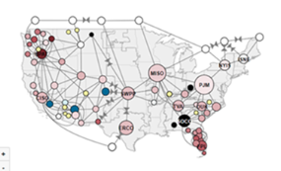
Data Collection and Preprocessing
Data Source: U.S. EIA Grid Monitor (Hourly data, 2022–2025).
Preprocessing Steps:
Missing values are handled by median imputation.
Unwanted columns are dropped(e.g., forward-looking forecasts to avoid leakage).
Feature engineering:
Temporal features are added like hour, day, month.
Holiday flag.
Aggregated generation metrics.
Normalization of values between 0 and 1(Min-Max Scaler).
Notes:
002

Slide 5
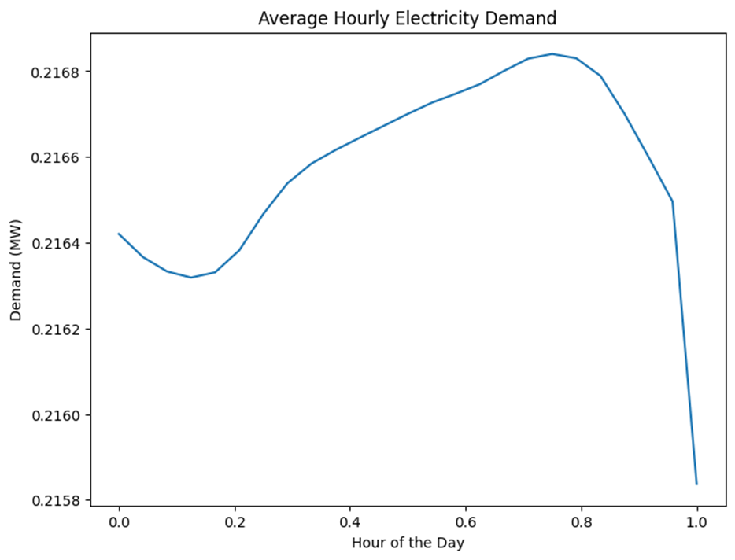
Exploratory Data Analysis
Notes:
002

Slide 6
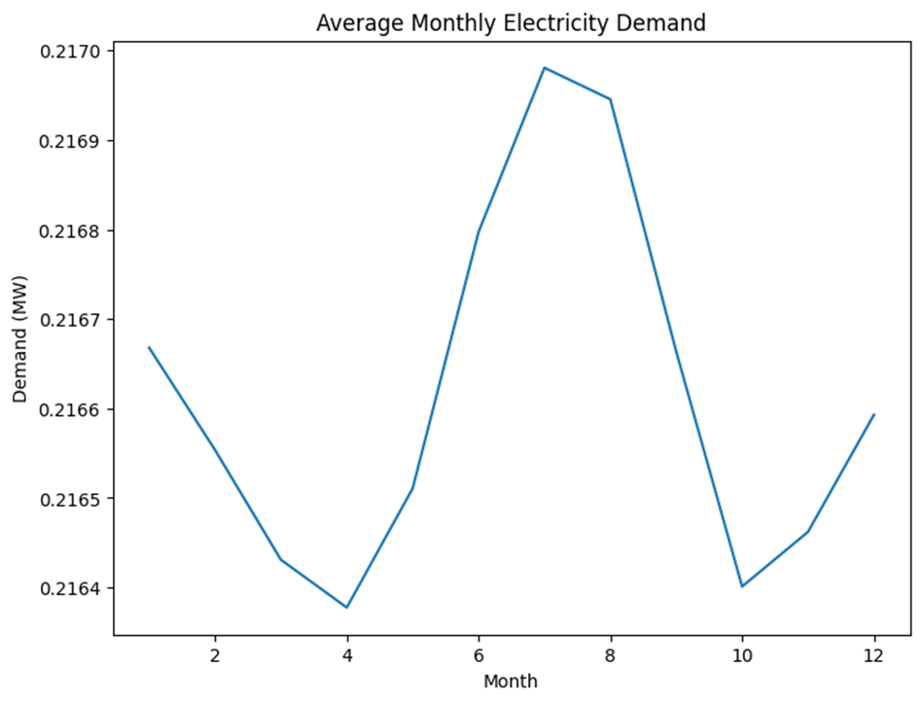
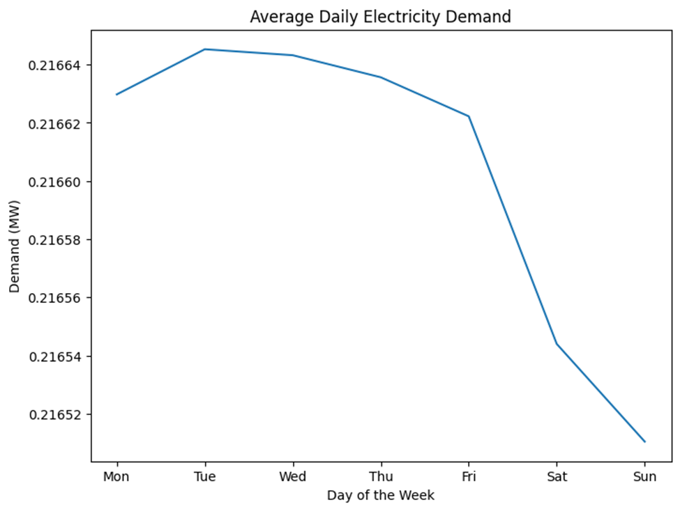
Notes:
002

Slide 7
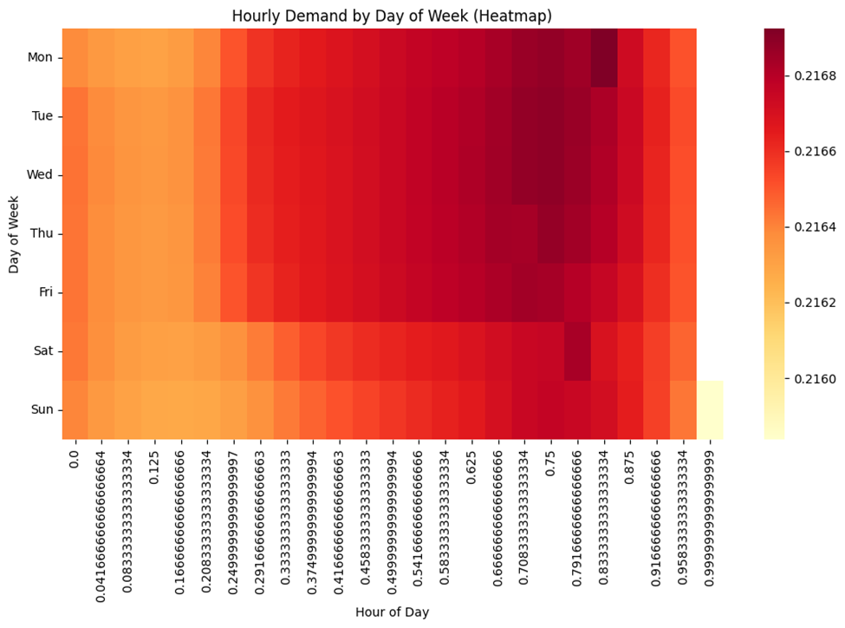
Monthly Demand
Notes:
003

Slide 8
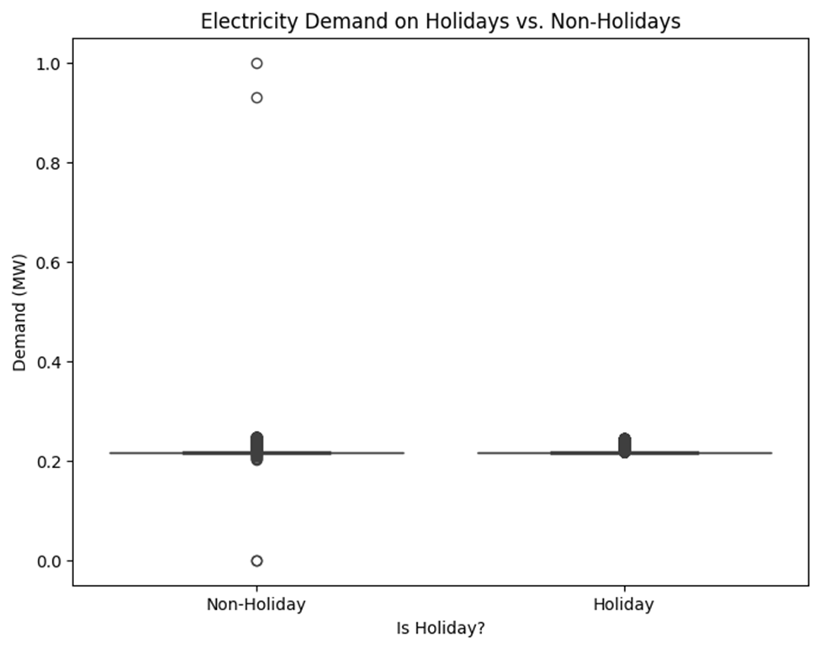
Hourly Demand Heatmap
Notes:
003

Slide 9
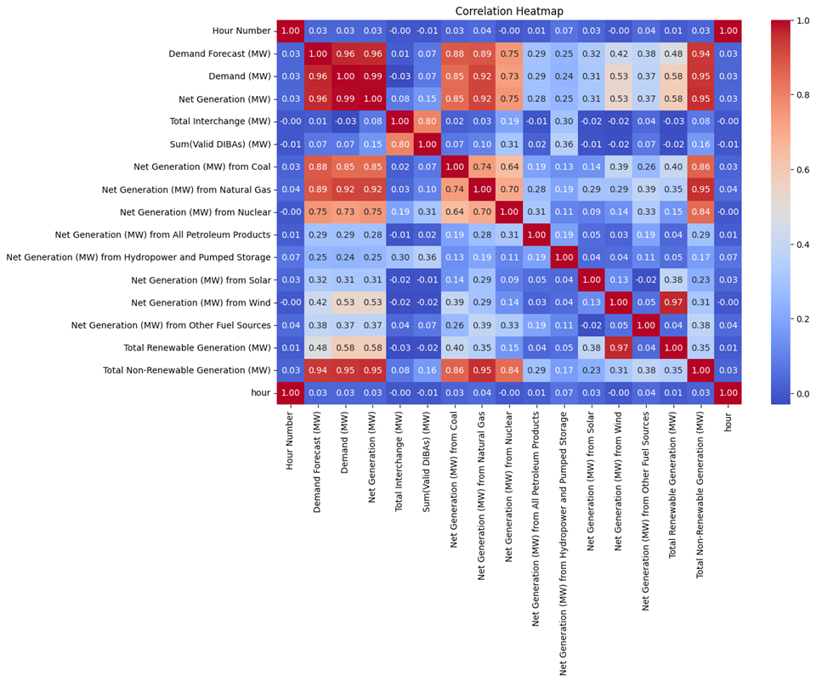
Correlation Heatmap
Notes:
003

Slide 10
Model Architectures
Hyperparameter | Value
Sequence Length | 24 (past 24 hours)
Batch Size | 64
Epochs | 20–50 (with early stopping)
Optimizer | Adam
Learning Rate | 0.001
Loss Function | Mean Squared Error
Callback | EarlyStopping (patience=5)
Models Used:
LSTM: 2 layers, 50 units each, dropout (0.2).
GRU: Similar to LSTM but with GRU units.
Simple RNN: Baseline model.
Notes:
004

Slide 11
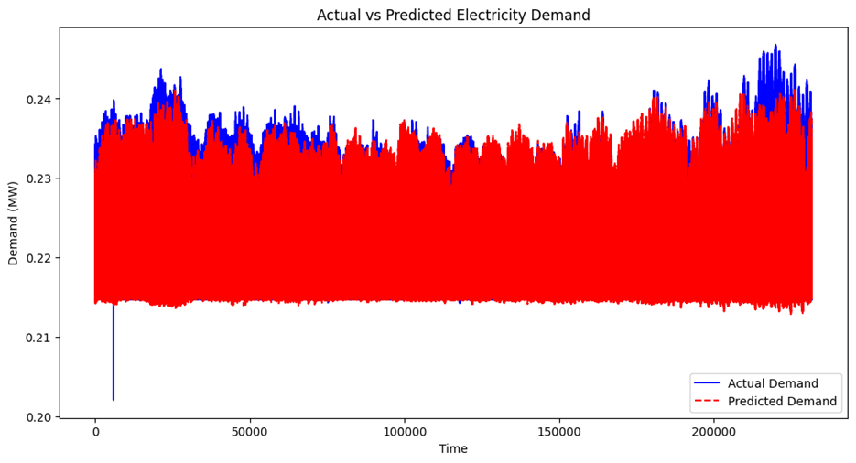
Evaluation Results
Metrics Comparison:
LSTM: MAE = 0.0098, RMSE = 0.0135.
GRU: MAE = 0.0101, RMSE = 0.0139.
Simple RNN: MAE = 0.0123, RMSE = 0.0168.
Key Findings:
LSTM outperformed GRU and Simple RNN.
Predictions closely followed actual demand
Symmetric error distribution
Notes:
004

Slide 12
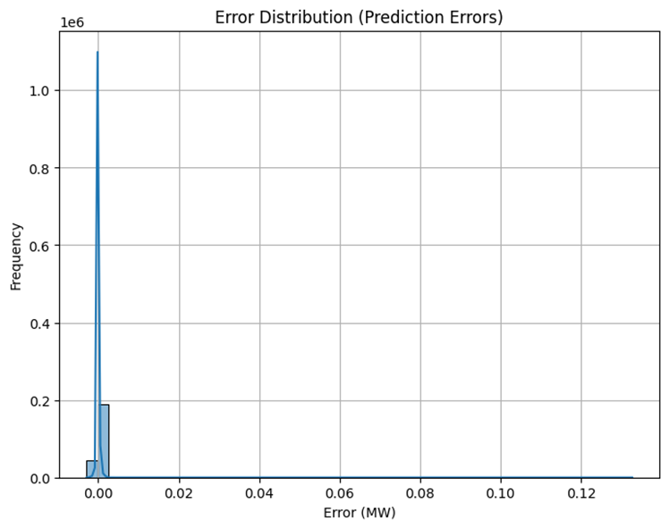
Prediction Error Distribution
Notes:
004

Slide 13
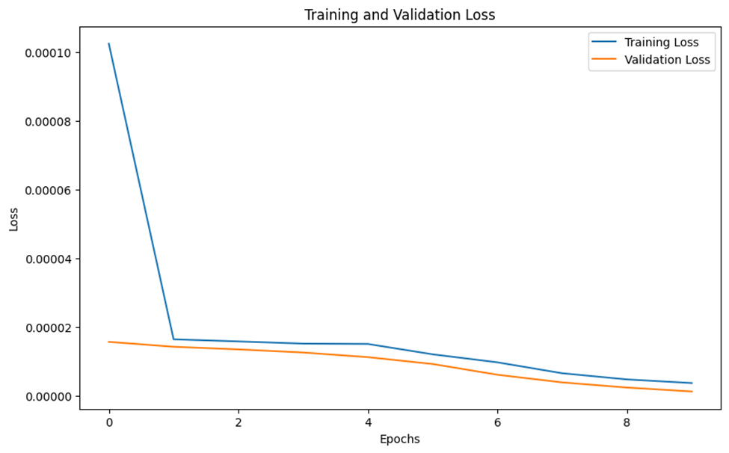
Actual vs Predicted Demand
Notes:
004

Slide 14
Conclusion
Summary:
LSTM had achieved the best performance for hourly demand forecasting.
Temporal features like hour, day, holidays were critical.
Proper data cleaning and leakage avoidance improved model performance.
Impact:
Supports smarter grid management and renewable integration.
Usage :
Improve grid efficiency, reduce costs, and prevent blackouts.
Notes:
005

Slide 15
Limitations and Future Work
Limitations:
Regional nuances generalized.
Future Work:
Incorporate weather data (e.g., NOAA API).
Deploy models regionally.
Explore Transformer-based architectures (e.g., Informer).
Build an interactive dashboard for grid operators.
Notes:
005

Slide 16


